Slide 1
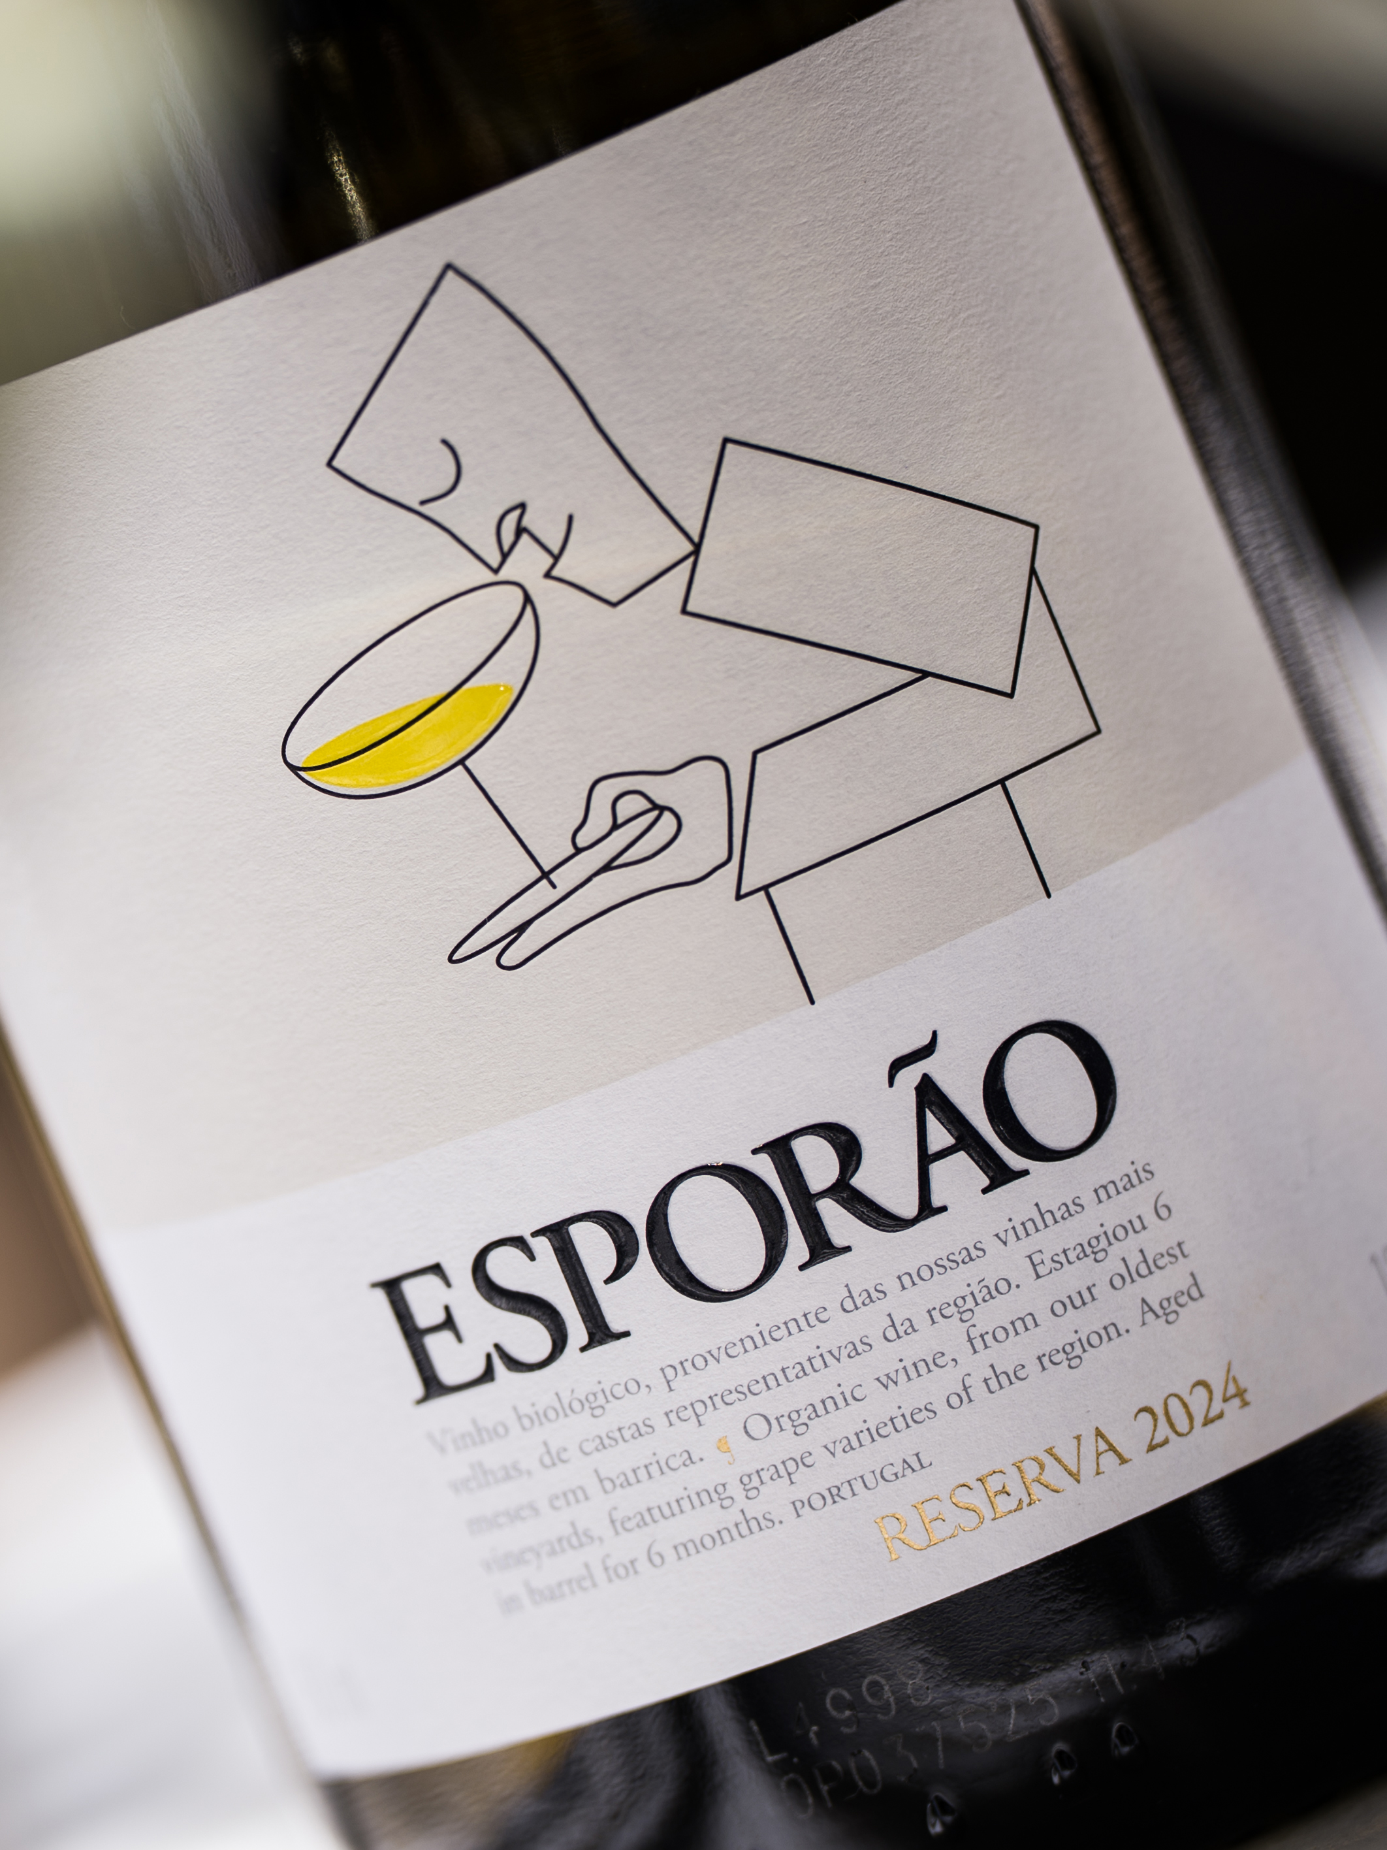
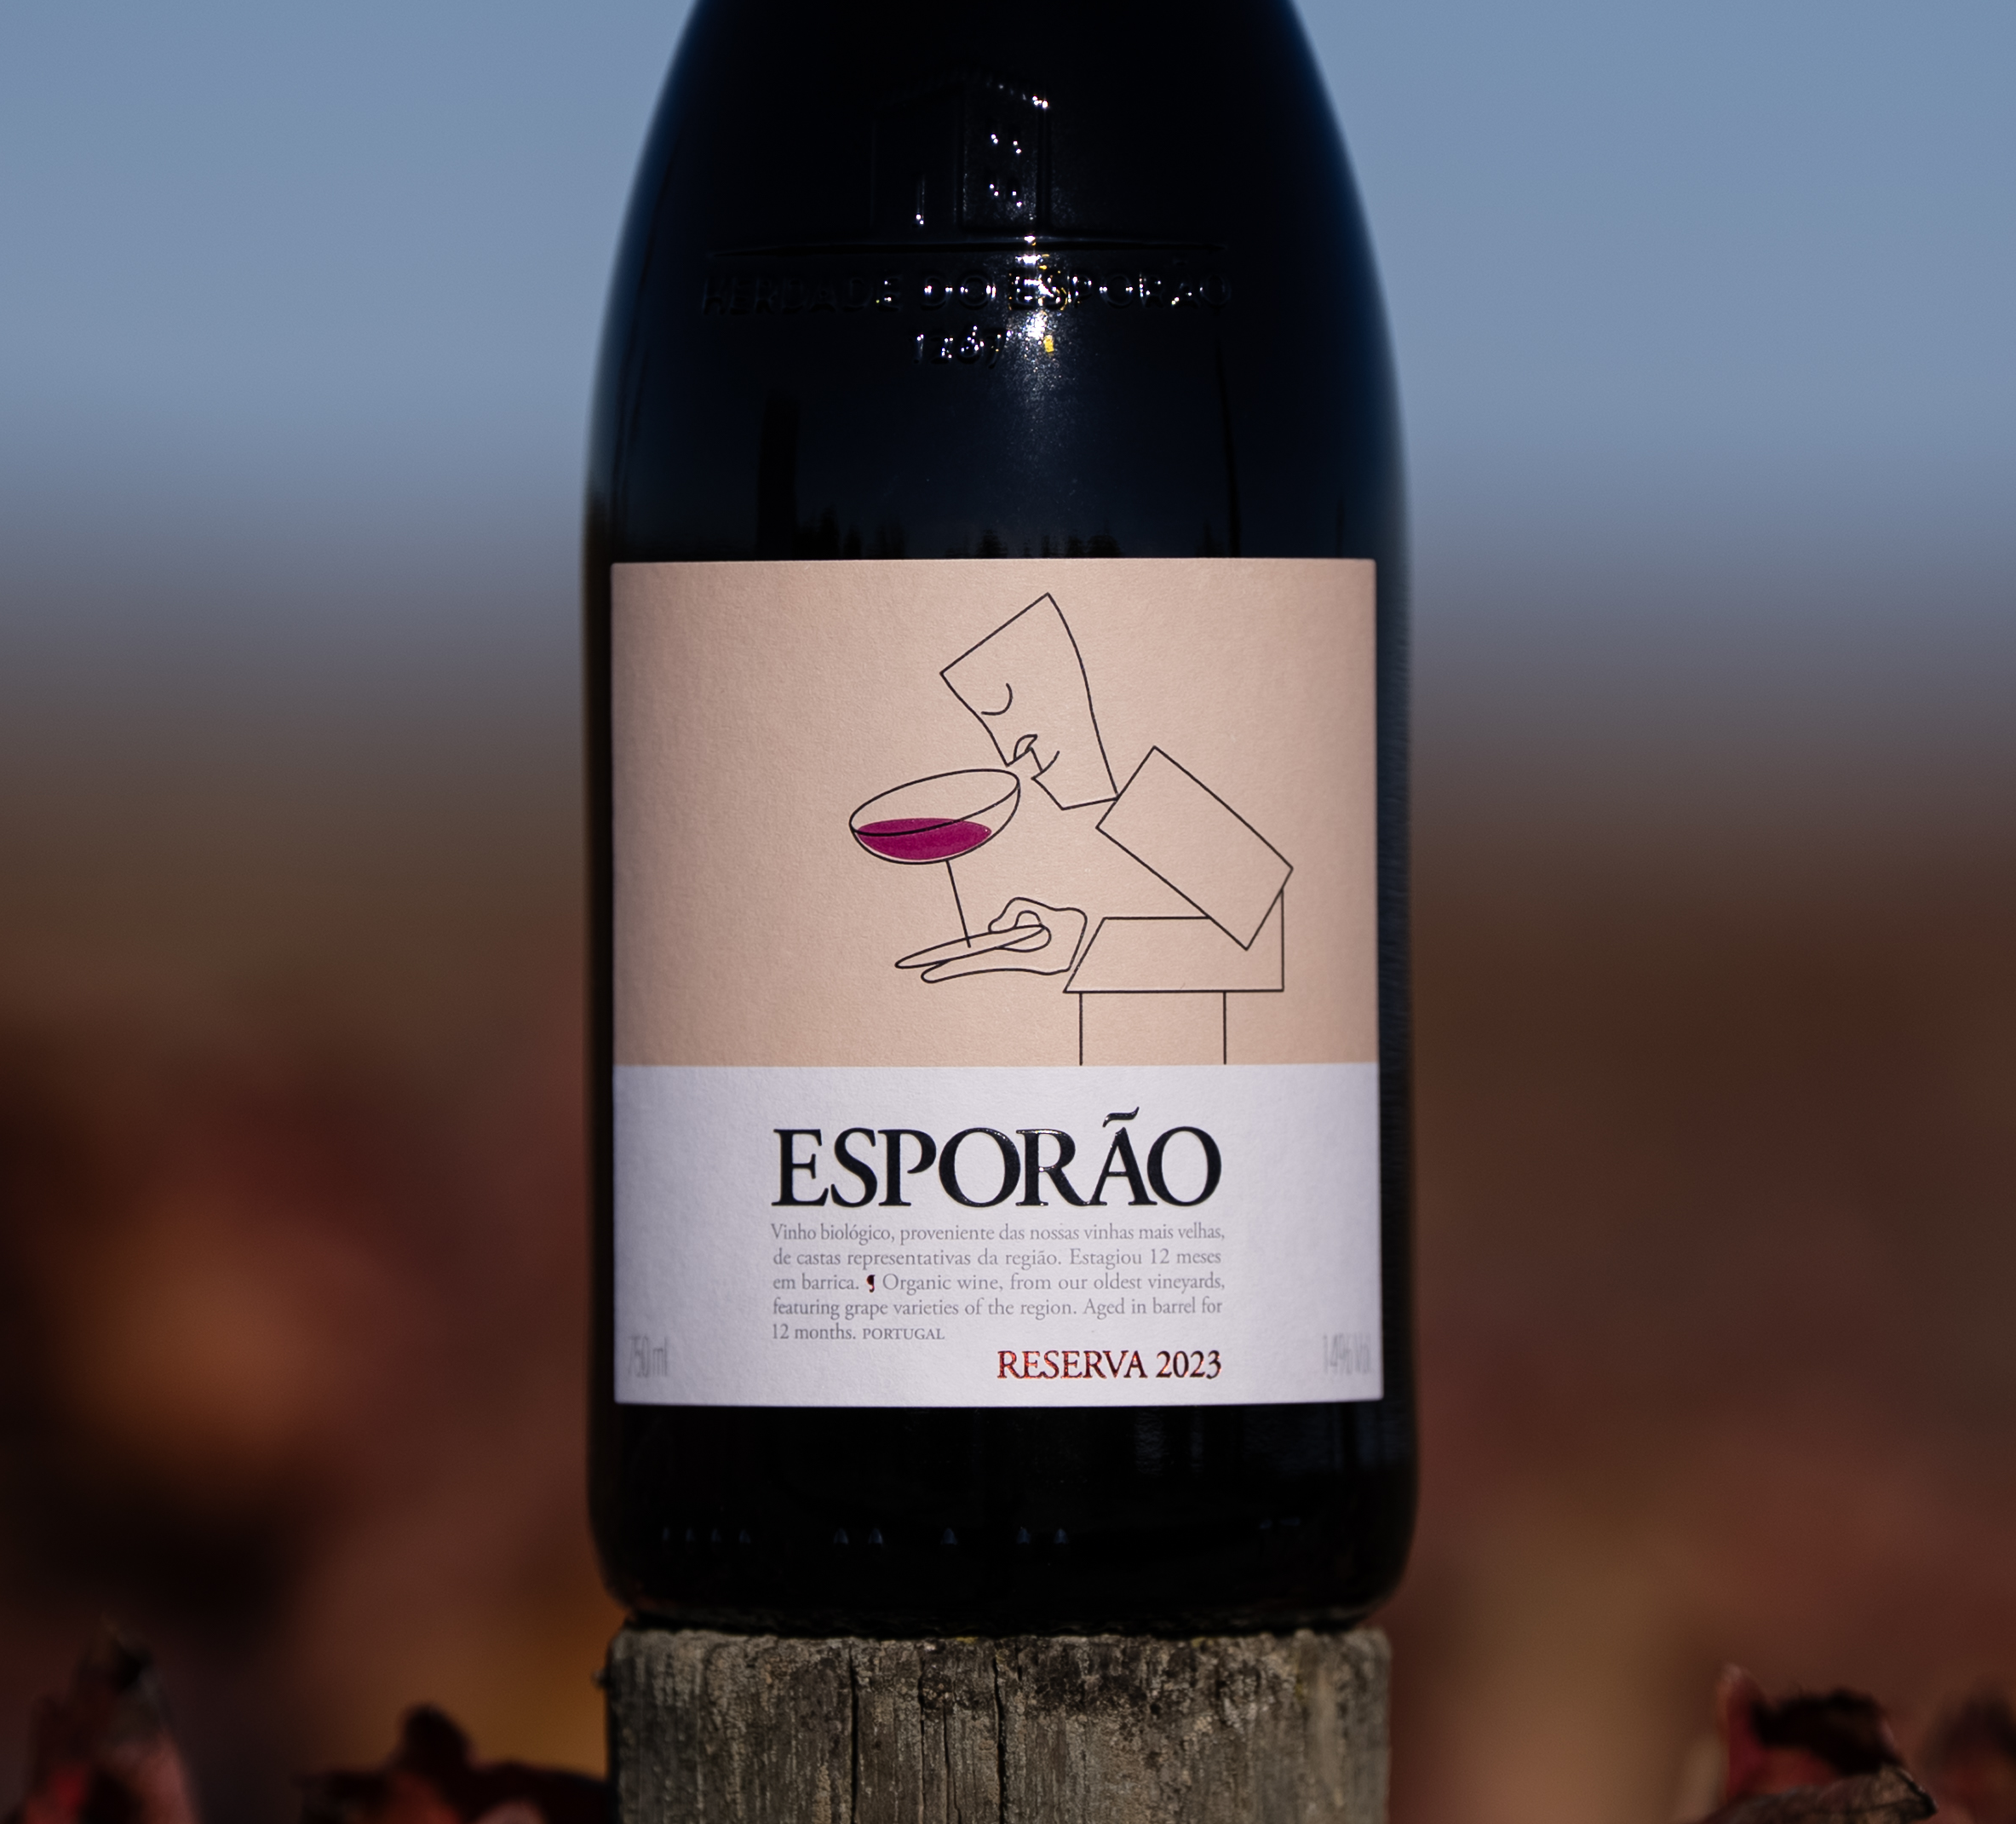
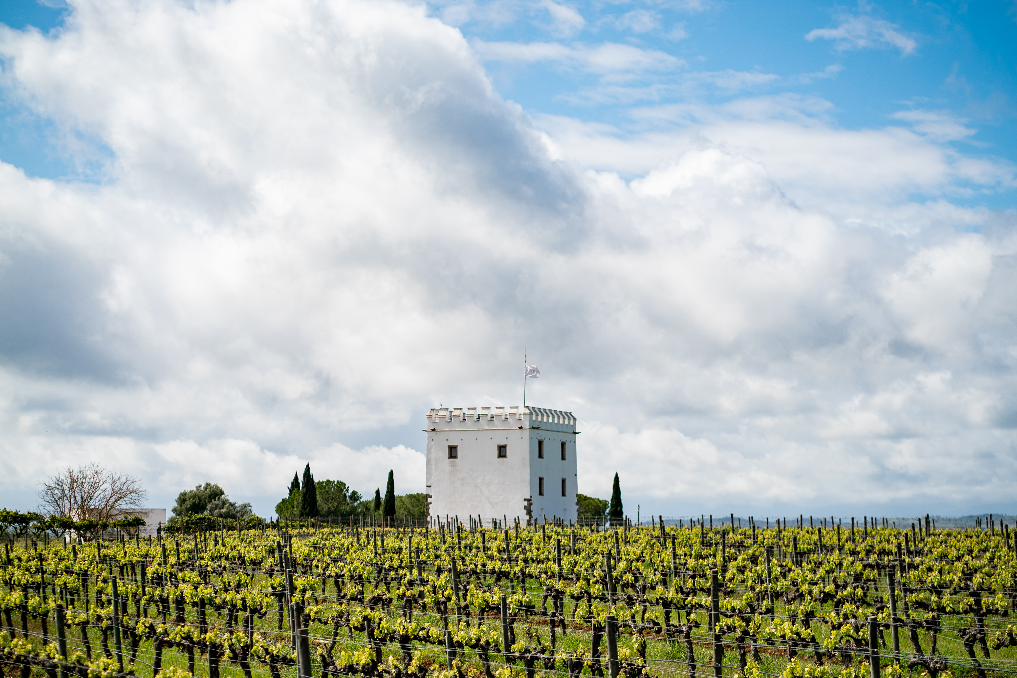

New Artist Series labels by Álvaro Siza Vieira
Esporão Artist Series Reserva
ABOUT THE WINES
2024 White
Expresses the balance between intensity of fruit, fresh acidity, and structure from aging in barrel, representing the best of the Esoprão estate’s vines and soils. A white wine for red wine drinkers.
2023 Red
The benchmark red blend of Alentejo: aromatic, intense, with finely structured tannins and vibrant, complex fruit profile. A timeless wine that can age for decades.
Both wines are 100% organic.
ABOUT THE ARTIST & ARTWORK: Álvaro Siza Vieira is a world-renowned Portuguese architect specializing in contemporary design since the 1960s, and winner of the prestigious Pritzker Prize.
For the Artist Series labels, he created a design that represents the “idea that the figure is a specialist,” a tribute to the “dedication and mastery shared between those who design spaces and those who make wine.”
The groundbreaking Esporão Reserva wines, established in 1985, are Alentejo’s—and perhaps Portugal’s—first and most iconic fine wines, and continues to serve as the highest expression of place, terroir, and art.
Learn more in the Library

